Slide 1
Data Integration Roadmap for Azure Data Factory and SSIS
STL BI User Group Nov ‘18
Luke Newport
lnewport@microsoft.com
Technical Specialist – Data & AI
github.com/newportl/adfln
Notes:
What have we been up to in this space?

Slide 2
Agenda
Current State
ADF & SSIS target scenarios ADF & SSIS roadmap
Progress
Roadmap – Data Flow
Demos
Q&A
Notes:
Current State
Where we are
Progress since V1, if you’ve seen ADF before.
What is ADFv2’s role in being the data integration story in Azure.
When/if you’re ready to move onprem SSIS up to the cloud, we now have a compelling offering in managed SSIS instances
Clear path to Azure here for SSIS.

Slide 3
Refresher

Slide 4
Current State: Data Integration
Azure Data Factory
Version 1 – Data pipelines for time-series data processing
Version 2 – Data Integration Service
Data Pipelines: serverless data integration
SSIS Packages: managed SSIS execution environment
SSIS: Server software for ETL
Windows / Linux
Focused on ETL to/from SQL Server
Scale up data transformation engine
Rich ecosystem (BIML, Task Libraries, etc)
Notes:
We had ADFv1 and SSIS and they didn’t play nice together and it was difficult to use and explain.
Today, that story has changed, walk top down.
If you’re talking about data integration in the cloud, we now have a single answer in ADFv2. Don’t cringe, this includes SSIS management and orchestration.
Bringing those two things into one service offering in the cloud.
V2, big change. V1 was very tailored to tumbling window/time series type data. Works great for that, doesn’t generalize well to the breadth of data integration scenarios.
The model in DF is very familiar Data Flow/Control flow if you are familiar with SSIS/Informatica, etc.
Two options.
Data Pipelines
Exec Environment for SSIS
What about on-prem SSIS?
Within the last year, we’ve added Linux and Cloud support.
Same runtime, minor changes around local file system etc.

Slide 5


Current State: Data Integration
Azure Data Factory (v2) – Data Integration Service
Data Pipelines:
Familiar application model (control flow / data flow)
Provides serverless orchestration, data movement and monitoring services
Hybrid Data movement as a Service w/ 70+ connectors
Visual and Programmatic authoring and monitoring (.NET, PS, Python)
Visual data transformation (Data Flow)
SSIS Packages:
Managed SSIS execution environment in Azure (no VM management)
Lift and shift your SSIS workloads to the cloud
SQL Standard & Enterprise
SSIS: Server software for ETL
Windows / Linux / Azure (in ADF)
Focused on ETL to/from SQL Server
Scale up data transformation engine
Rich ecosystem (BIML, Task Libraries, etc)
Notes:
Data Pipeline:
Best, managed cloud based EL ETL, etc.
Or
I’m invested in SSIS. Use DF as a managed execution environment.
Take the management away.

Slide 6
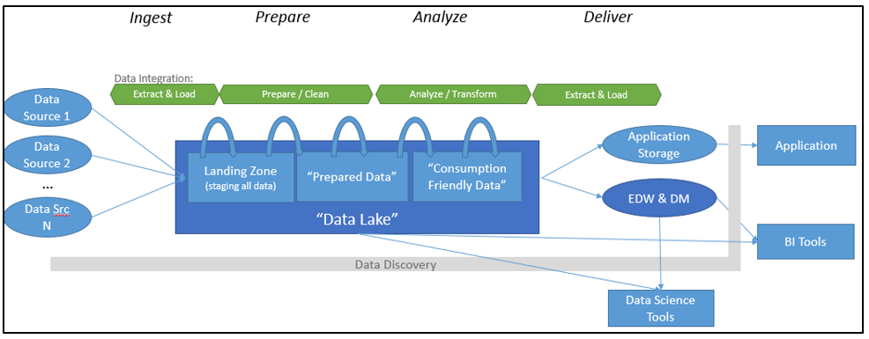
Target Scenarios
Lift Existing SSIS+SQL to the Cloud:
Moving infrastructure to cloud
Run existing SSIS packages in a managed cloud environment
Modern Data Warehouse
“For Enterprise Analytics”: modernizing from traditional DW to reduce cost & scale to the variety/volume of big data
“For Data-Driven SaaS Apps”: ISV building their app out of IM PaaS building blocks
App Storage
SaaS
App
Browser/Device
Data Tier
App Tier
Notes:
These are the efforts the PG is putting in for ADFv2.
Talk about onprem SSIS + DW + DB, moving things to cloud. If DB is cloud, keep moving the SSIS base up.
Moving from ETL to DW – now we’re talking about data lakes, scaling to the size of big data, and not breaking the bank.
Take your data from wherever it might be, ingest into DL or Blob store, then process scaleout with DataBricks or HDL or ADLA. Once you’ve shaped that data, pushing it into a store where you can analyze it.
The green part is where ADF fits in.
EA = driving BI.
Vs SaaS apps where the whole data integration piece looks like the top graphic, but then we push it into an app store/db/cosmos etc to feed your app.

Slide 7
New Pipeline Model
Rich pipeline orchestration
Triggers – on-demand, schedule, event, tumbling window
Data Movement as a Service
Cloud, Hybrid
70+ connectors provided
Data Transformation as a Service
Visual authoring, code-free, Azure DataBricks Compute
SSIS Package Execution
In a managed cloud environment
Use familiar tools, SSMS & SSDT
Author & Monitor
Programmability (Python, .NET, PowerShell, etc)
Visual Tools
Data Factory
Managed Data Integration Service
New!
Notes:
A little more on cloud here. Quick concise slide here on Data Integration at MSFT.
Any data integrator used to traditional tools, you’ll be at home. Modeled off of those styles.
Completely serverless from that perspective of orchestration.
First class notion of trigger. Based on time/event/demand. The theme here is new application model.
Data Movement as a Service, key piece
With others, get data into cloud, then we’ll do stuff. Lots of code/human effort here.
No extra charges
S3 to blob store. Go. No code, fully managed.
SSIS
You know it, to adopt ADF you don’t have to abandon that.
If you want ADF to manage packages for you, it can do so. Lift it up with high compat.
Same SSIS runtimes. Same tools – SMSS SSDT
Visual tooling just added about three weeks ago – big gap from last year.

Slide 8


On Prem Apps & Data
Cloud Services, Apps & Data
Notes:
I’ve got data everywhere, on prem other clouds, SAP etc.
I want to use one tool to get it up into the cloud, once I get it up, I want to use the various Azure tools to process that data.

Slide 9
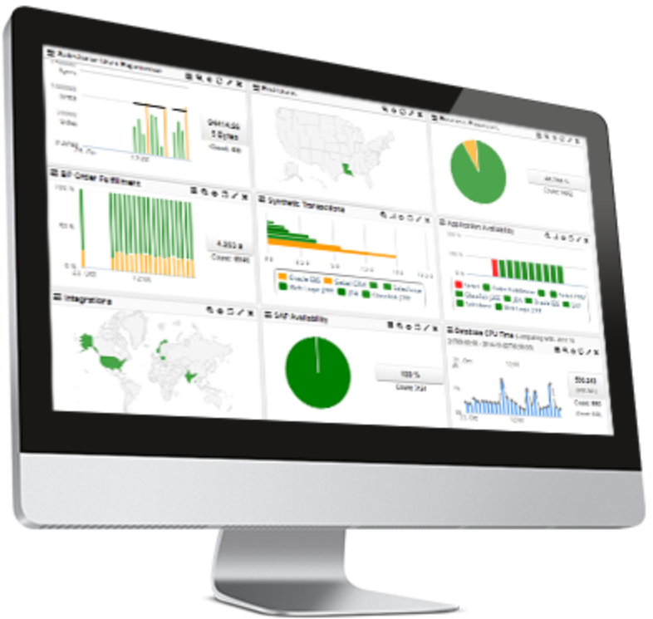
Command and Control
Data
Data Factory
A data integration account
Location of orchestration, service metadata
UX & SDK
Authoring | Monitoring/Management
Azure Data Factory v2 Service
Scheduling | Orchestration | Monitoring
Integration Runtime (IR)
ADF’s execution engine
Three core capabilities:
data movement
pipeline activity execution
SSIS package execution
Self Hosted
Integration Runtime
Azure
Integration
Runtime
On Prem Apps & Data
Cloud Services, Apps & Data
Notes:
Create – doesn’t spin up anything, doesn’t cost anything.
When you create it, you’re telling us where to store metadata. AND where does the orch puppeteering occur from.
Runtime. Everything you can create and run runs in that runtime.
Self hostable, installable version of what we have in the cloud.
It does three things.
Runs data movement service.
Pipeline. Copy some data to blob store, execute this spark script – the thing that does this is the IR. It might submit it to another service acting as kind of a dispatch and monitoring system.
SSIS package execution. Turn on SSIS, we’ll ask how many nodes, etc. 15-20 minutes. Looks like an SSIS server, use typical tools, etc.

Slide 10
Command and Control
Data
Data Factory
A data integration account.
Location of orchestration, service metadata
UX & SDK
Authoring | Monitoring/Management
Azure Data Factory v2 Service East US 2
Scheduling | Orchestration | Monitoring
Integration Runtime (IR)
ADF’s execution engine
Three core capabilities:
data movement
pipeline activity execution
SSIS package execution
Pipeline
SSIS Package
Self Hosted
Integration Runtime
Azure
Integration
Runtime
On Prem Apps & Data
Cloud Services, Apps & Data
Notes:
Dotted line command and control, orange line is the actual flow of data.
Data is point to point.
Point of self host, something to use when you want to run pipeline activities outside of the azure cloud. Specifically when there is a line of sight boundary, like we can’t establish a TCP connection, from our orchestration system to the actual integration activity.
Ie, you want to copy data from an onprem Oracle server up into SQL DB. So we aren’t going to reach out from Azure down and scrape out those rows, rather we’ll have the self hosted integration runtime hosted behind the firewall as the thing that will communicate with that Oracle server and pump data directly to azure sql db etc.
The dotted line is always outbound over HTTPS TO the cloud. Think of this as tethered server software to your cloud.
Do you have Express Route? Ie no line of sight boundary? Then no self hosted integration required.

Slide 11
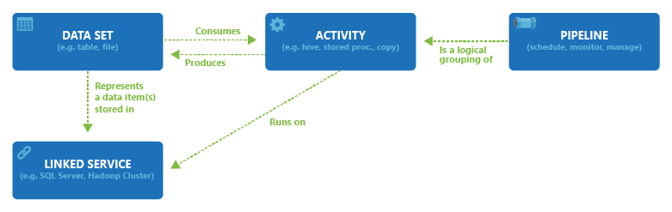
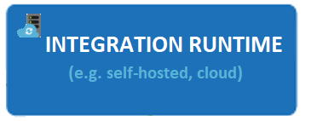

Data Factory entities

Slide 12





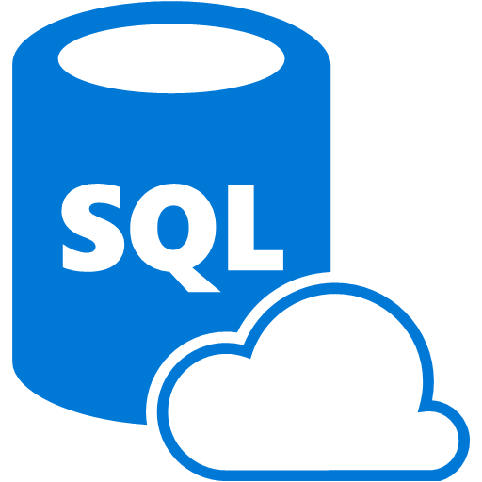
Azure Data Factory Service Data Flow Concepts
Datasets
(Collection of files, database table, etc)
Activity: a processing step
(Hadoop job, custom code, ML model, etc)
Pipeline: a sequence of
activities (logical group)
Data Sources
Ingest
Transform & Analyze
Publish
Call Log Files
Call Log Files
Transform, Combine, etc
Analyze
Move
Visualize
Customer Table
Customer Table
On Premises
Data Mart
Customer Call Details
Customers Likely to Churn
Customer Churn Table
Azure Data Lake
Azure DW

Slide 13
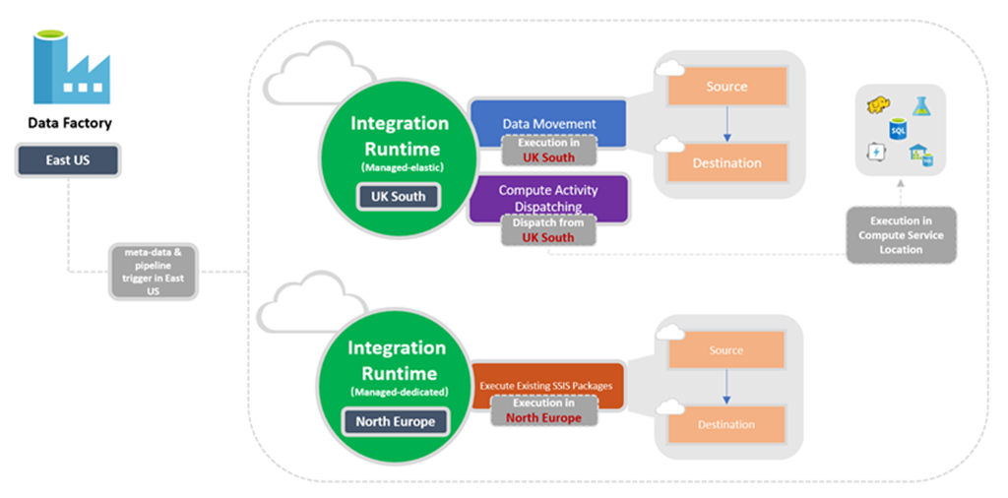
Data Sovereignty

Slide 14
Data Factory Security/ Compliance
Compliance Certifications
Data Sovereignty
Data security at Rest (SQL TDE, etc.)
Supported Auth types
Credential management, Key Vault Integration
Network and Firewall requirements (Azure SQL DB, SQL DW, Redshift, etc.)
Cloud-cloud
On-Premesis
vNET
Hybrid Network Topology
SSIS Package execution (Case study)
Notes:
Certifications:
HIPAA/HITECH
ISO/IEC 27001
ISO/IEC 27018
CSA STAR

Slide 15
Access all your data
70+ connectors & growing
Azure IR available in 20 regions
Hybrid connectivity using self-hosted IR: on-prem & VNet
Azure | Database |  | File Storage | NoSQL | Services and Apps |  | Generic
Azure Blob Storage | Amazon Redshift | SQL Server | Amazon S3 | Couchbase | Dynamics 365 | Salesforce | HTTP
Azure Data Lake Store | Oracle | MySQL | File System | Cassandra | Dynamics CRM | Salesforce Service Cloud | OData
Azure SQL DB | Netezza | PostgreSQL | FTP | MongoDB | SAP C4C | ServiceNow | ODBC
Azure SQL DW | SAP BW | SAP HANA | SFTP |  | Oracle CRM | Hubspot
Azure Cosmos DB | Google BigQuery | Informix | HDFS |  | Oracle Service Cloud | Marketo
Azure DB for MySQL | Sybase | DB2 |  |  | SAP ECC | Oracle Responsys
Azure DB for PostgreSQL | Greenplum | MariaDB |  |  | Zendesk | Oracle Eloqua
Azure Search | Microsoft Access | Drill |  |  | Zoho CRM | Salesforce ExactTarget
Azure Table Storage | Hive | Phoenix |  |  | Amazon Marketplace | Atlassian Jira
Azure File Storage | Hbase | Presto |  |  | Megento | Concur
 | Impala | Spark |  |  | PayPal | QuickBooks Online
 | Vertica |  |  |  | Shopify | Xero
 |  |  |  |  | GE Historian | Square
 |  |  |  |  | Web table
* Supported file formats: CSV, AVRO, ORC, Parquet, JSON

Slide 16
Demo – ADF Walkthrough

Slide 17
Visual Data Flow Authoring
Transform Data, At Scale, in the Cloud, Zero-Code
Cloud-first, scale-out ELT
Code-free dataflow pipelines
Serverless scale-out transformation execution engine
Maximum Productivity for Data Engineers
Does NOT require understanding of Spark / Scala / Python / Java
Resilient Data Transformation Flows
Built for big data scenarios with unstructured data requirements
Operationalize with Data Factory scheduling, control flow and monitoring

Slide 18
Visual Data Flow Key Tenets
Visual “Data Flow Builder” / “Data Mapping”
Extensible through scripting and expressions
Data Flow can be embedded into ISV / SaaS apps
Embed UI
Embed Parameterize Data Flows
A graphical UI for building data transformation routines on Spark
Built for resiliency and operationalized environments

Slide 19
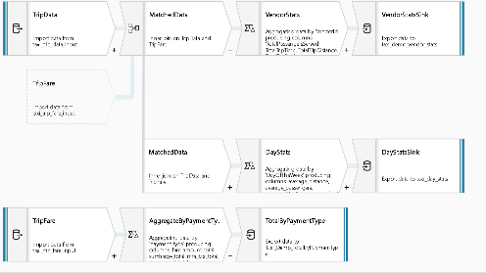
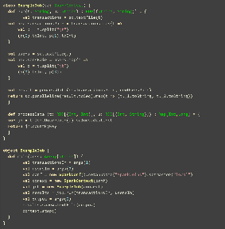
Code-free Data Transformation At Scale
Does not require understanding of Spark, Big Data Execution Engines, Clusters, Scala, Python …
Focus on building business logic and data transformation
Data cleansing
Aggregation
Data conversions
Data prep
Data exploration
… not …

Slide 20








ADF Data Flow Workstream
Data Sources
Staging
Transformations
Destination
Sort, Merge, Join, Lookup …
Explicit user action
User places data source(s) on design surface, from toolbox
Select explicit sources
Implicit/Explicit
Data Lake staging area as default
User does not need to configure this manually
Advanced feature to set staging area options
File Formats / Types (Parquet, JSON, txt, CSV …)
Explicit user action
User places transformations on design surface, from toolbox
User must set properties for transformation steps and step connectors
Explicit user action
User chooses destination connector(s)
User sets connector property options

Slide 21
Demo – ADF Data Flow

Slide 22
Resources
Azure Data Factory Documentation
ADF Labs, 10 part series
Azure Data Factory Data Flow Documentation
Request Preview & Support : adfdataflowext@microsoft.com

Slide 23
Appendix

Slide 24
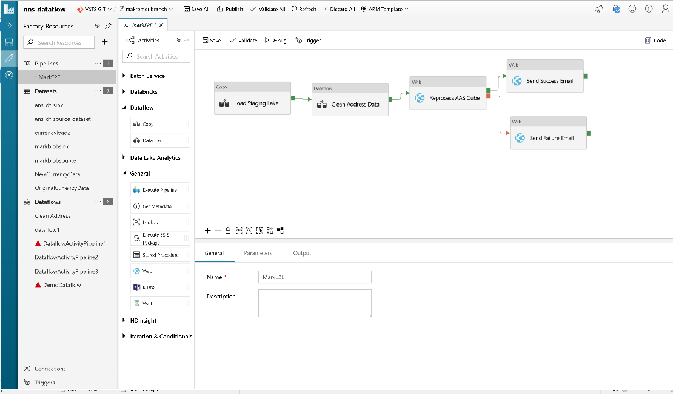

Slide 25
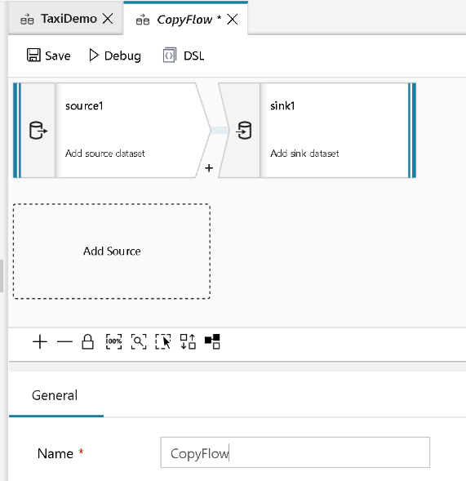
Simple Copy Flow

Slide 26
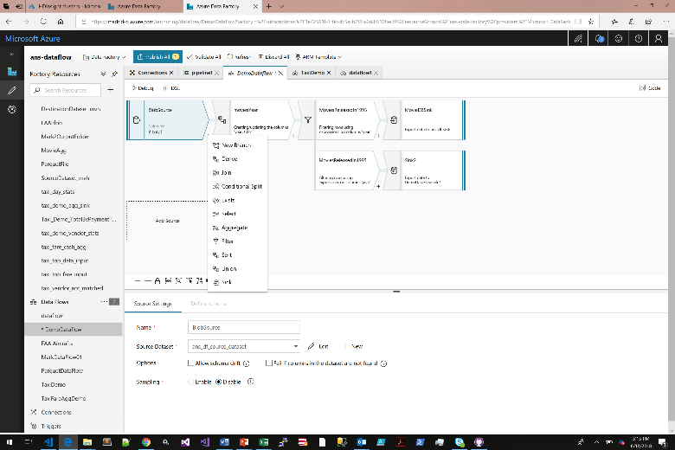
Build your logical data flows adding data transformations in a guided experience

Slide 27
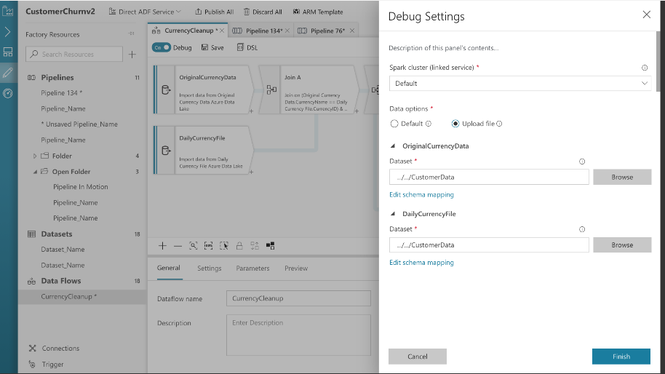
Switch to Debug Mode and select sample data to work with for debugging

Slide 28
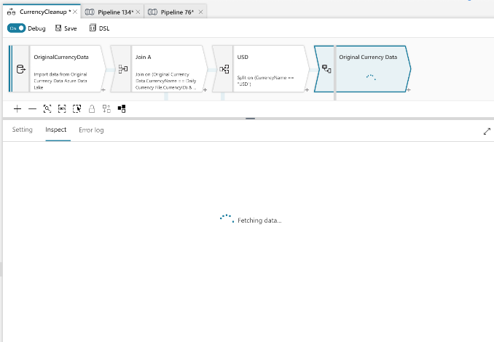
Debug mode provides row-level context and visible results in inspector pane

Slide 29
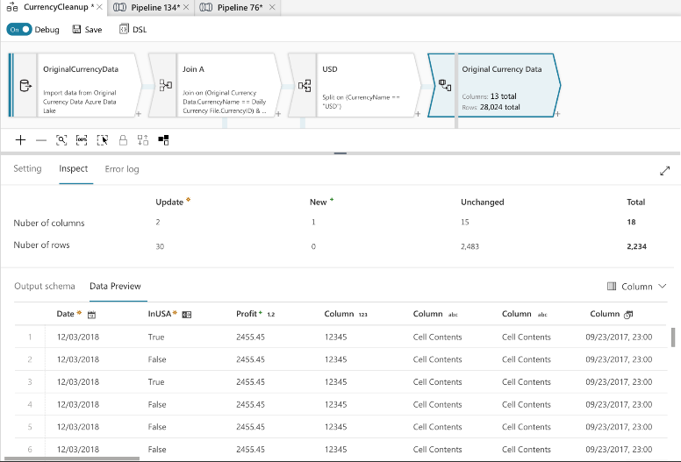
Debug mode provides row-level context and visible results in inspector pane

Slide 30
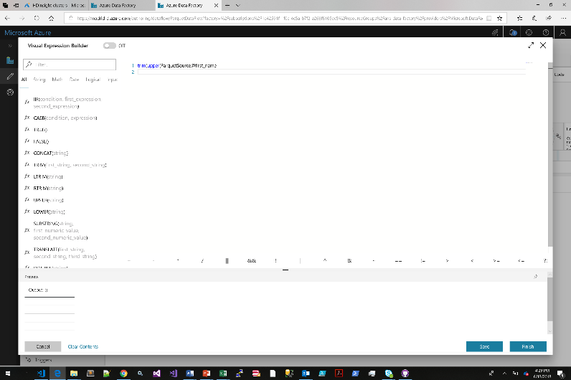
Interactive Expression Builder – Build data transform expressions, not Spark code

Slide 31
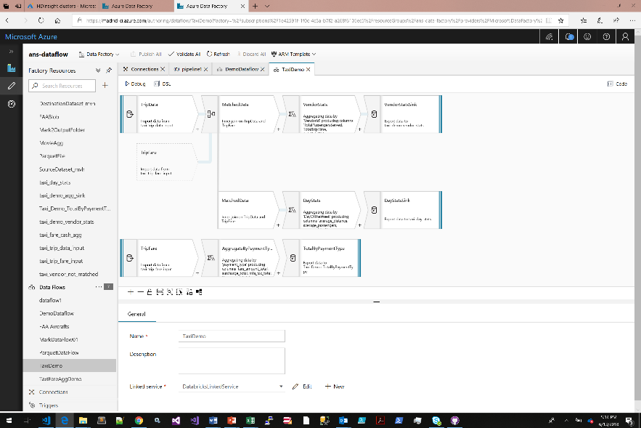
Azure Data Factory Visual Data Flow

Slide 32
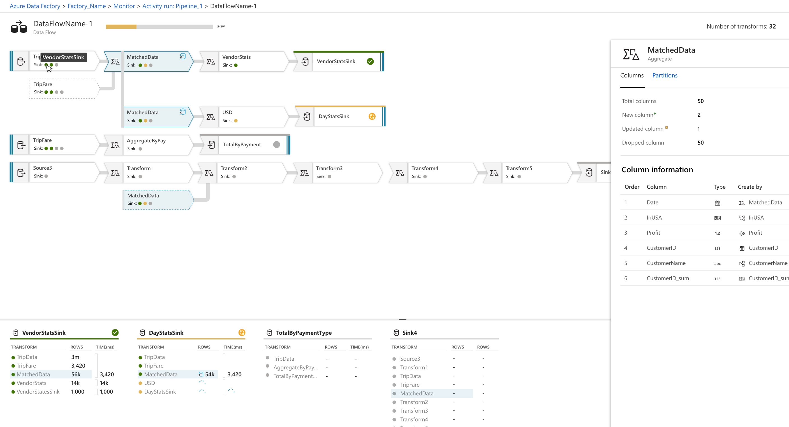
Deep Monitoring Introspection of Data Transformations

Slide 33
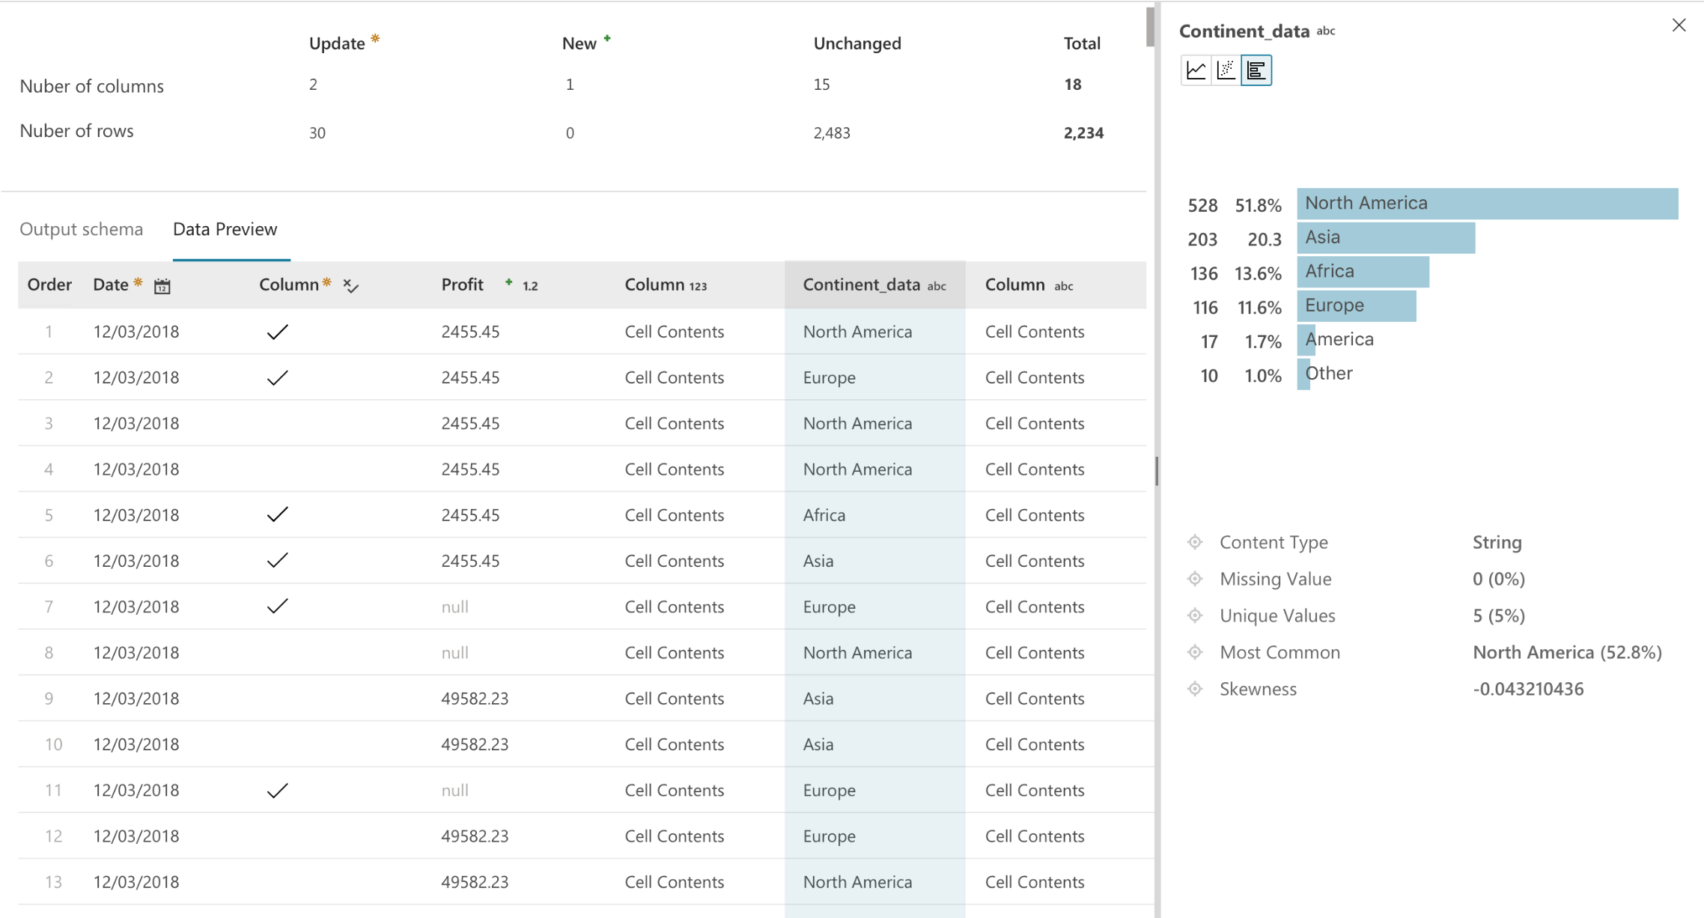
Debug Data Flows with Data Preview and Data Sampling

Slide 34
Build Resilient Data Flows with Schema Drift Handling

Slide 35
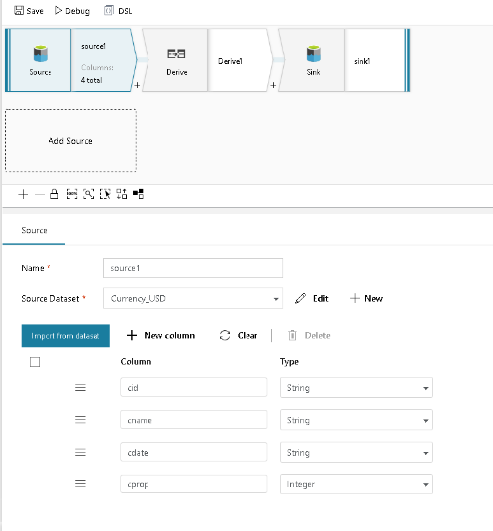
Data Engineer Defines Source will take ALL fields from the source file with flexible schema

Slide 36
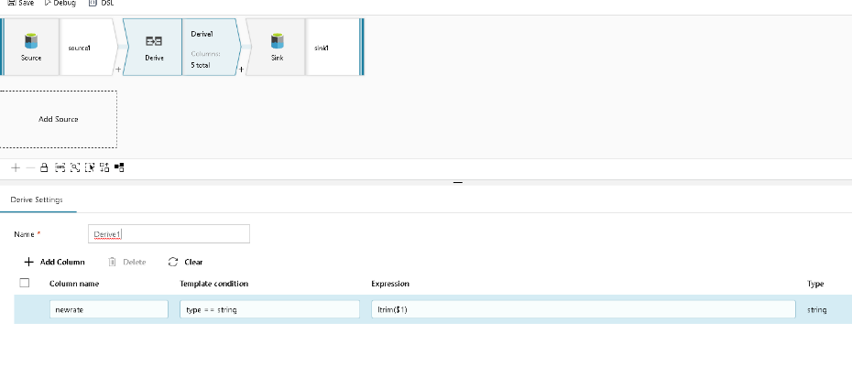
Data Engineer derives columns using template expression patterns based on name and type matching. No need to define static field names.

Slide 37
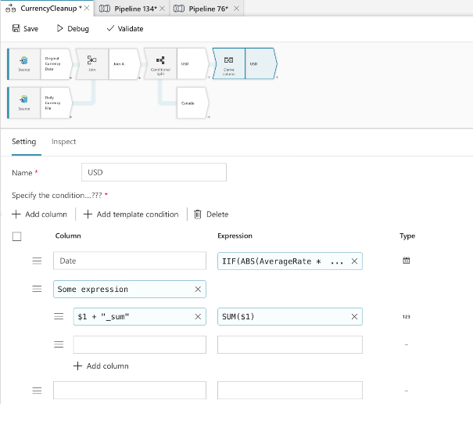
Data Engineer derives columns using template expression based on name and type matching. No need to define static field names.

Slide 38
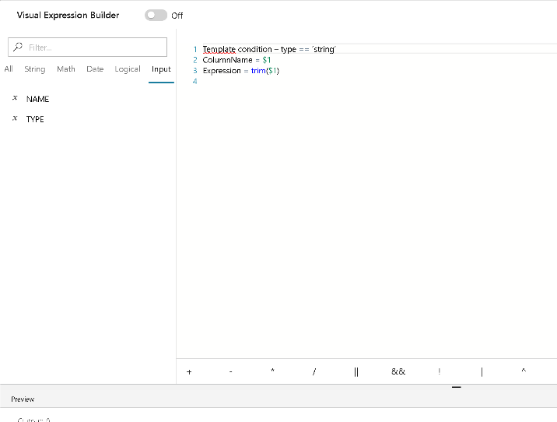
Data Engineer derives columns using template expression based on name and type matching

Slide 39
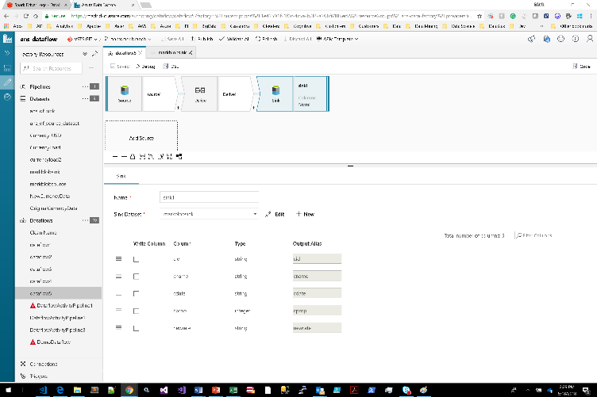
Sink all incoming fields along with new derived field

